Slide 1


Steel Defect Detection using ml
PG-DBDA
Sept-22
Project guide : presentation by :
Dr Shantanu Pathak Vyom Tiwari (220941225054)

Slide 2
Contents ---------------------------------------------------------------------------
Abstract
Problem statement
Objective
Workflow
Data Preparation
MODEL
Result and conclusion
References

Slide 3
Abstract
Steel industry have the major problem of classify the steel sheets, so they manually done this process, but there is a lot of cost involve in this. So to solve this problem we are developing a solution to classify steel sheets on the basis of images of the sheets.
The main objective of this classification project is to classify the steel sheets images in to defective and un-defective classes. Here we have used models like Resnet50 and Sequential model to classify the image.

Slide 4
Problem Statement
Steel Defect Detection Classification Using Deep Neural Network and Keras .
There are images without defect as well. Therefore it will be useful if we first filter data with defects from the one without defect. For this purpose we will build a classifier whose job will be to classify sample image as defect (1) or without defect (0).

Slide 5
Aim & objective
Aim :- Aim of the project is to build a classification model to classify the images into Defective and un-defective classes.
Objective of this project is help steel industry to save cost by applying the solution to segregate the low quality steel sheets.

Slide 6
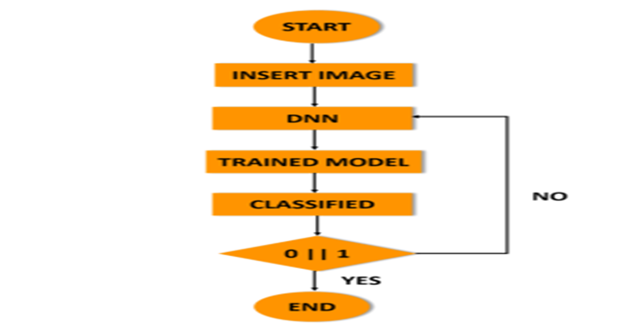
WORKFLOW

Slide 7
Data Preparation
Our label data only have defective labels so for classification we need un-defective labels also .
So we written a code to append the un-defective in the csv file .
We have used os lib , pandas for this.

Slide 8
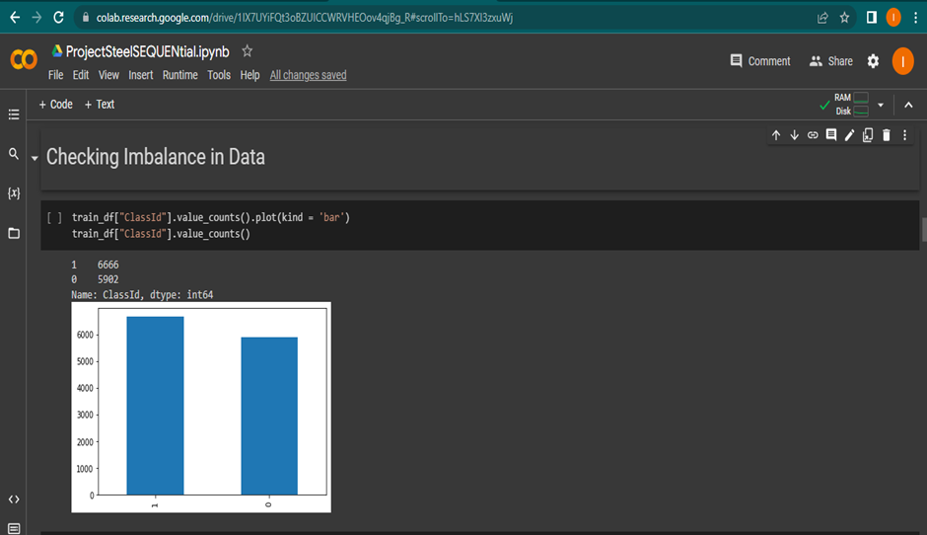
Checking Data Imbalance

Slide 9
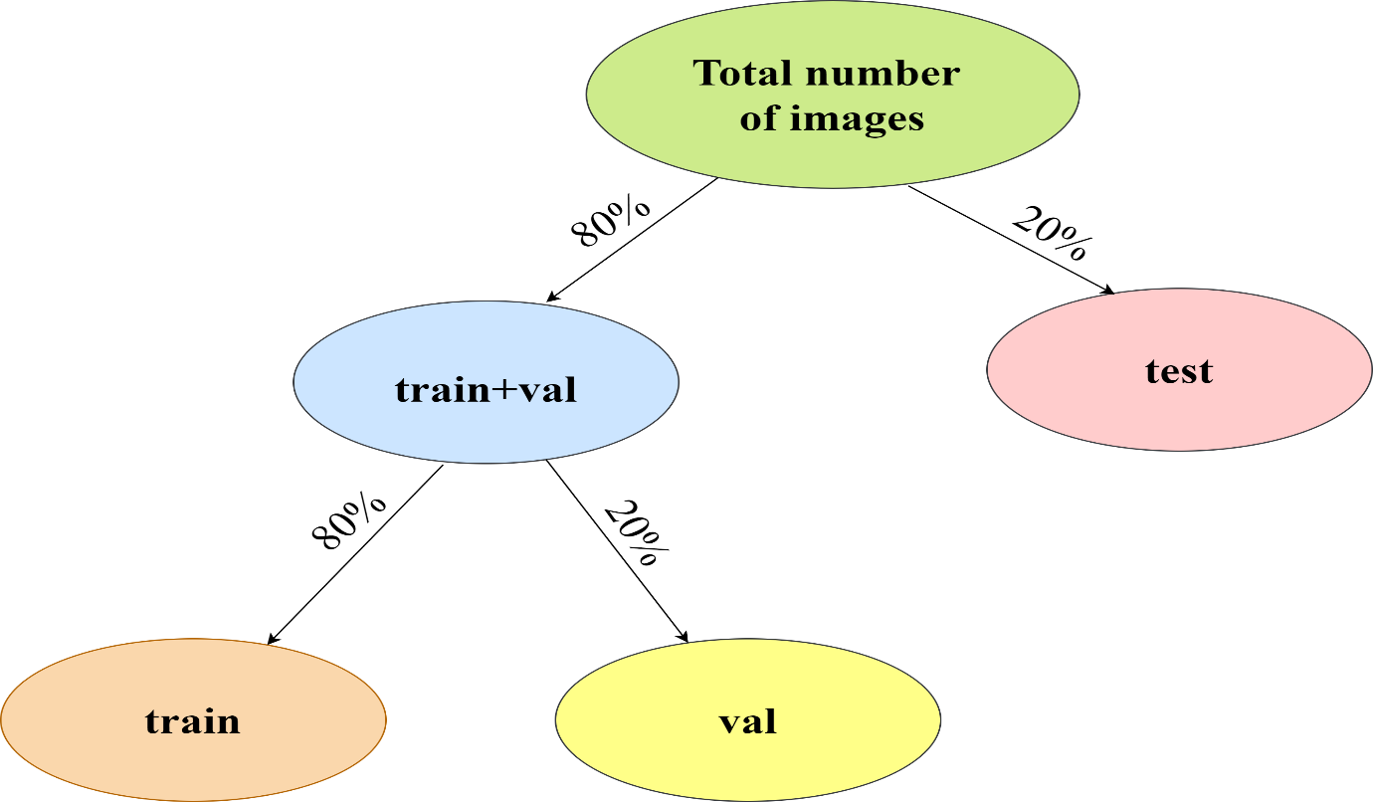
Train Test Split

Slide 10
Image Data Generator
We have initialised the data generators and in we set some image pro processing steps .
Normalization
Data augmentation
Edge detection
Colour space conversion

Slide 11
Machine learning models used
1. Sequential Model - A sequential model is a type of neural network architecture in deep learning that is composed of a linear stack of layers. Each layer in the stack receives input from the layer directly preceding it, and passes its output to the layer directly following it.
.

Slide 12
2. In a sequential model, data flows in a single direction from input to output, with no branching or loops. The most common type of layer in a sequential model is the dense layer, also known as a fully connected layer. Other types of layers that can be used in a sequential model include convolutional layers, pooling layers, and recurrent layers.
3. Sequential models are often used for tasks such as image classification, where the input data is a fixed-size image and the output is a categorical label. They can also be used for tasks such as natural language processing, where the input data is a sequence of words and the output is a sequence of words or a categorical label

Slide 13
Machine learning models used
Resnet50 (pre-trained model)- The ResNet50 model is composed of 50 layers, including convolutional layers, pooling layers, and fully connected layers. It has been trained on a large dataset (usually Image-Net) using a technique called pre-training, which involves training the model on a large dataset of images and then using the learned features to train the model on a new dataset.
Transfer learning is a technique in which a pre-trained model is used as a starting point for a new task, and then fine-tuned on a smaller dataset of images specific to the new task. This approach can save a significant amount of time and computational resources, as the model has already learned a set of features that are relevant to the new task.

Slide 14
Optimizers, early stopping, Model check pointing
In this project we use adam optimizer.
Early stopping used to save the computing power , because there is no improvement in the loss.
Model check pointing used to save the best model on the basis of minimum loss
save only the best model .

Slide 15
Evaluation Parameters
Accuracy: This measures the percentage of correctly classified images by the model.
Precision: This measures the percentage of true positives among the images that the model classified as positive.
Recall: This measures the percentage of true positives among all the actual positive images.

Slide 16
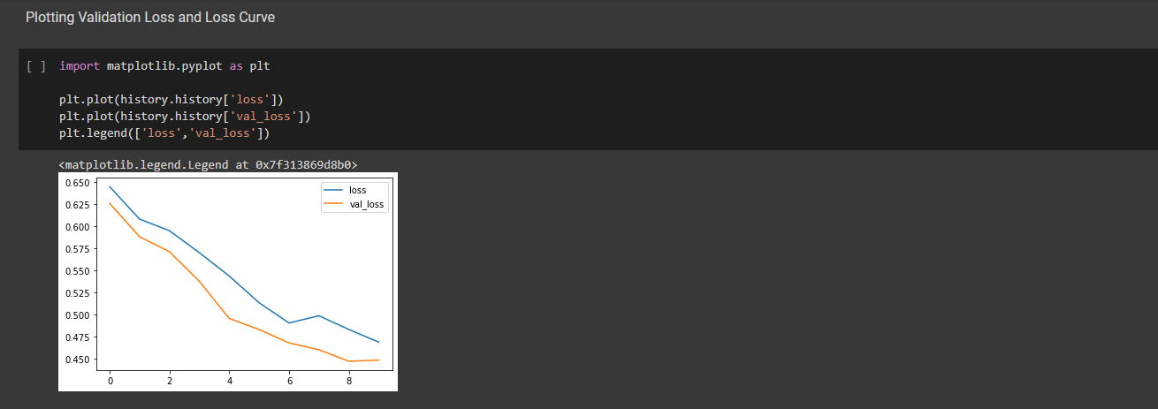
Loss vs validation loss curve

Slide 17
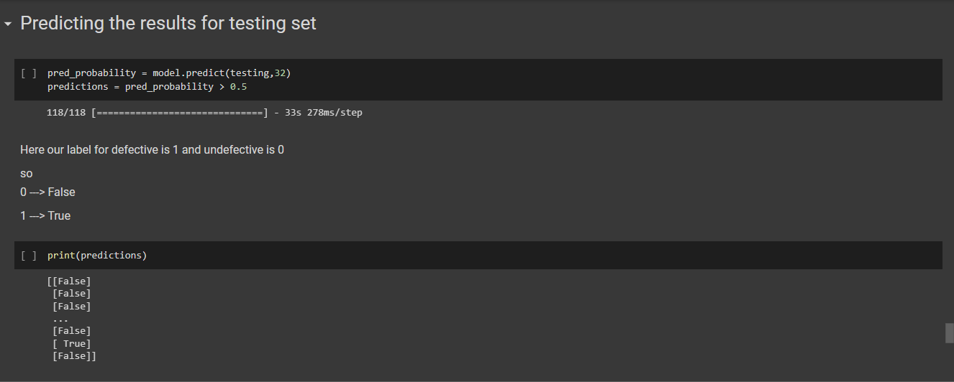
Predictions

Slide 18
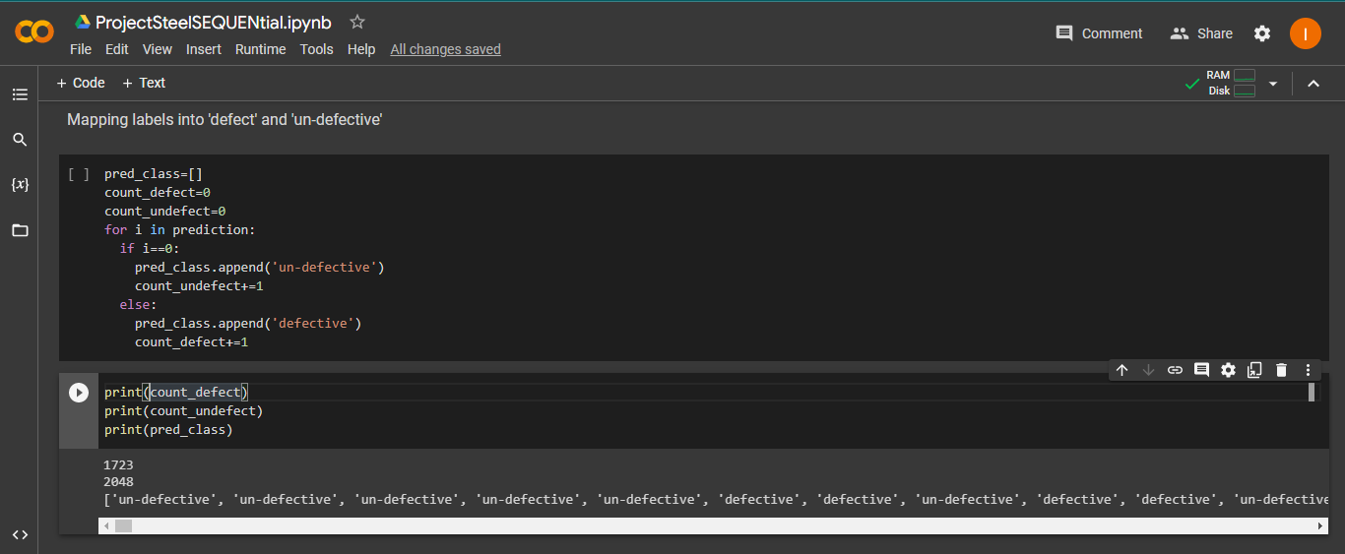
Mapping labels with predictions

Slide 19
Conclusions
In this project we have used steel sheets image to classify the defects in the image. We have also the train.csv for defects labelling but no label for un-defective images so we have applied the data preparation to label the un-defective images. Then we check the imbalance in the dataset. Then we perform the train test split and merge the x_train and y_train, same for x_test and y_test. Then we initialize the image data generator to fetch the image data from the dataset. Then we write the code for early stopping and model check pointing. Then we start the training the model and we train only layer which is added on top of the pre-trained model. Then we do the prediction and map the probability with labels.
Sequential gives loss less than resnet50 in this case .
We use pre-trained model Resnet50 and Sequential model, sequential gives better result in this case.

Slide 20
references
Scikit learn libraries - https://scikit-learn.org/stable/
Pandas libraries –

